Slide 1
Static Modeling

Slide 2
Objectives
To understand three main types of relationships that may exist between classes
  Association
  Aggregation and composition
  Generalization/specialization
To understand static modeling of the problem domain
  Static modeling of the physical classes
  Static modeling of the entity classes
To understand static modeling of the system context

Slide 3
Static Model
A static model defines the classes of objects in the system, the attributes of the classes, the relationships between classes, and the operations of each class.

Slide 4
Relationships between Classes
Association
Aggregation and composition
Generalization/specialization

Slide 5
Association between Classes
An association defines a relationship between two or more classes.
  Example: Employee Works in Department

Slide 6
Multiplicity of Associations
The multiplicity of an association specifies how many instances of one class may relate to a single instance of another class.
One-to-one association
  Example: Company Has President
One-to-many association
  Example: Bank Manages Account
Many-to-many association
  Example: Course Has Student

Slide 7
Multiplicity of Associations (Cont’d)
Numerically specified association
  Example: Car Has Door
Optional association
  Example: Customer Owns Debit Card

Slide 8
Other Associations
Ternary association
  Example: Buyer Negotiates Price with Seller through an Agent
Unary association
  Example: Course Pre-requisite of Course

Slide 9
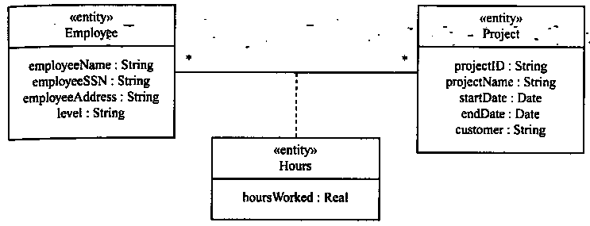
Association Classes
An association class is a class that models an association between two or more classes.
It is most useful in many-to-many associations.
The attributes of the association class are the attributes of the association.

Slide 10
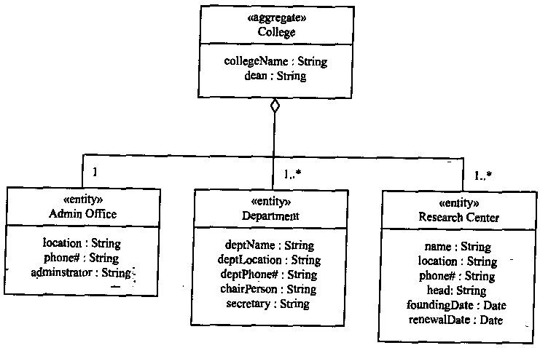
Aggregation Relationships
IS-PART-OF relationships

Slide 11
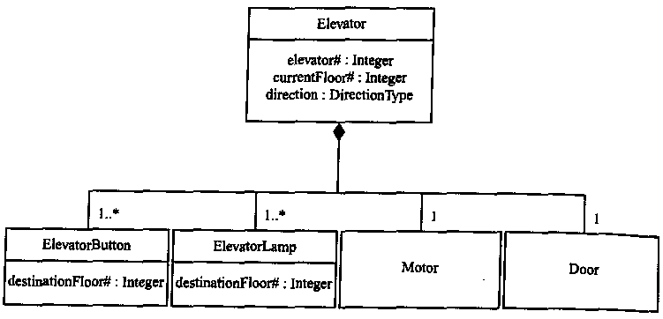
Composition Relationships
Composition is a stronger type of aggregation
  The part objects are created, live, and die together with the whole.

Slide 12
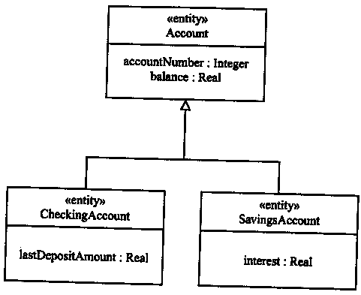
Generalization/Specialization Relationships
IS-A relationships

Slide 13
Static Modeling of the Problem Domain
Static modeling of the physical classes
  Physical classes are those classes that have physical characteristics, that is, they can be seen and touched.
  These include physical devices, users, external systems, and timers
Static modeling of the entity classes
  Entity classes are conceptual data-intensive classes.

Slide 14
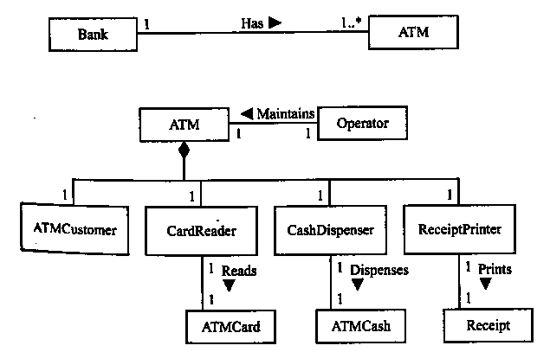
Conceptual Static Model for Banking System: Physical Classes

Slide 15
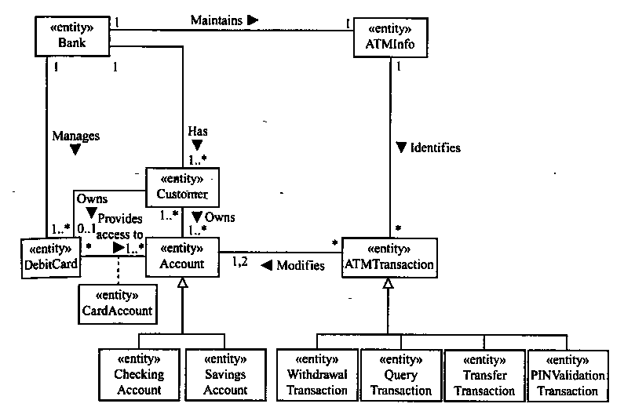
Conceptual Static Model for Banking System: Entity Classes

Slide 16
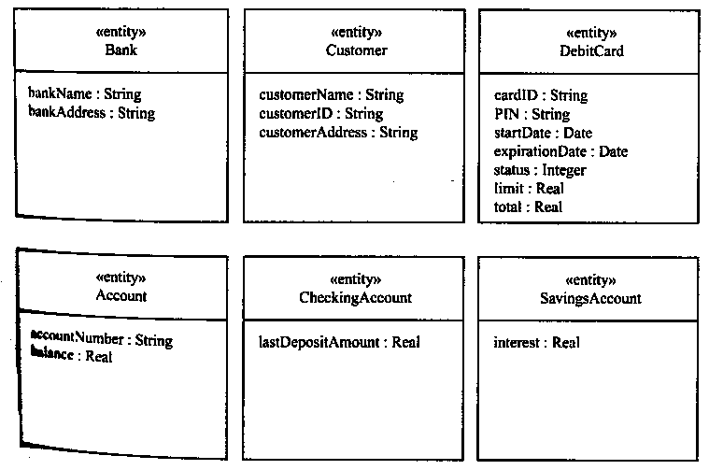
Conceptual Static Model for Banking System: Class Attributes

Slide 17
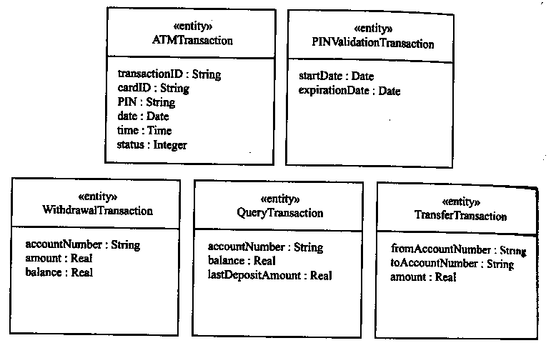
Conceptual Static Model for Banking System: Class Attributes (Cont’d)

Slide 18
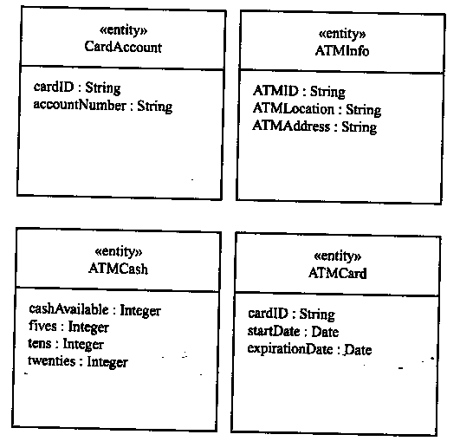
Conceptual Static Model for Banking System: Class Attributes (Cont’d)

Slide 19
Static Modeling of System Context
System context: the interface between the system and the external environment.
When modeling the problem domain, it is important to understand the boundary of the system by developing a system context class diagram.
The system context class diagram can be determined by static modeling of the external classes that connect to the system.

Slide 20
Static Modeling of System Context (Cont’d)
The system context is depicted showing the system as an aggregate class with the stereotype <<system>>
The external environment is depicted as external classes which the system has to interface.
  <<external input device>>
  <<external output device>>
  <<external I/O device>>
  <<external user>>
  <<external system>>
  <<external timer>>

Slide 21
Static Modeling of System Context (Cont’d)
If a user interacts with system via standard I/O devices (such as keyboard/display and mouse), the user should be represented as an external user class.
  The characteristics of these standard I/O devices are of no interest because they are handled by the operating system.
  The interface to the user is of much greater in interest in terms of what information is being output to the user and what information is being input from the user.
If a user interacts with the system via application-specific I/O devices, these I/O devices should be represented as external device I/O classes.

Slide 22
Static Modeling of System Context (Cont’d)
The standard association names on system context class diagrams are Inputs to, Outputs to, Interfaces to, Interacts with, and Awakens.
  <<external input device>> Inputs to <<system>>
  <<system>> Outputs to <<external output device>>
  <<external user>> Interacts with <<system>>
  <<external system>> Interfaces to <<system>>
  <<external timer>> Awakens <<system>>

Slide 23
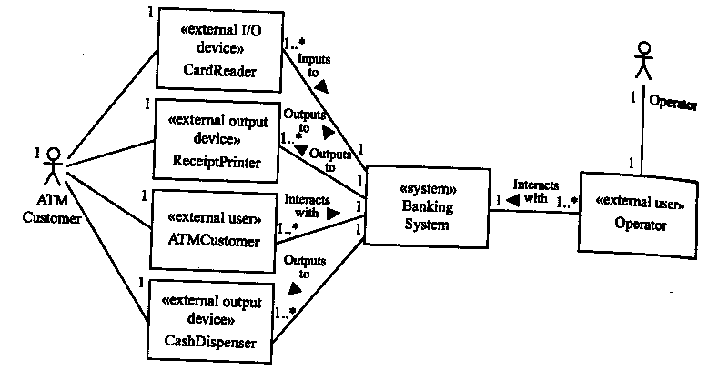
Banking System Context Class Diagram

